Slide 1
SPIMEU Newsletter January 2018
In the first SPIMEU newsletter of year you can read all about our progress since our last newsletter was published in May of this year. You can also find information about our upcoming events and goals. You can sign up for future SPIMEU newsletters on the SPIMEU website www.SPIMEU.org.
WONCA General Conference, Prague, 2017
In June/July 2017, the Czech Society of General Practice hosted the 22nd World Organization of National Colleges, Academies, and Academic Associations of General Practitioners (WONCA) Europe Conference in Prague. The aim of WONCA Europe is to improve global quality of life through fostering and maintaining high standards of care in general practice/family medicine. To this end, WONCA provides a forum for exchange of knowledge and information, encouraging and supporting the development of academic organizations of general practitioners/family physicians.
We ran a workshop on the barriers and facilitators of selective prevention of cardio-metabolic disease in Europe. The workshop featured three 10-minute talks on the differences in attitude towards CMD-preventive care among general practitioners and patients. Following the presentations, we facilitated a lively and fruitful conversation with the audience about how to best deal with diverging opinions and attitudes towards prevention in GP and patient populations.
Steering Group Meeting
In addition to participation in WONCA 2017, the SPIMEU team also held a steering group meeting on June 28 immediately before the conference. Here, we discussed and planned the next steps of SPIMEU with particular reference to WP2 and WP8.
WP2 relates to the devleopment of a ”tool-box” with recommendations for the design and implementation of CMD-prevention programs in all EU members states. The recommendations will be based on the results generated from the SPIMEU project, and will as such be the final deliverable of the project. This document is currently in development, but will be completed once results from all of the WPs have been finalized. An abstract will be published on the website once we have completed a first draft.
WP8 focuses on implementation of selective prevention interventions. Specifically, this WP will test the feasibility of implementing the tailored selective prevention programs (designed in WP7) in five EU Member States (SWE, DNK, CZE, NLD, GRE), in terms of their acceptance and participation rate. Read more about our progress on WP 8 on the following page.

Slide 2
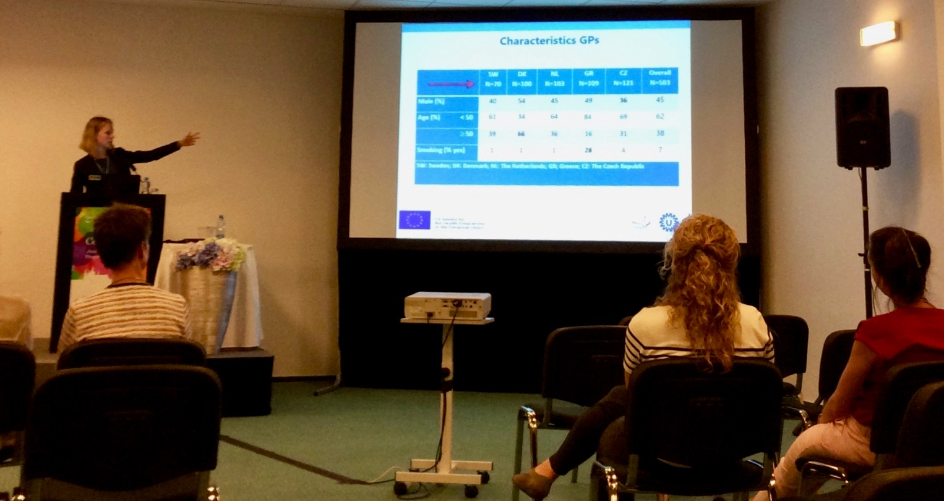
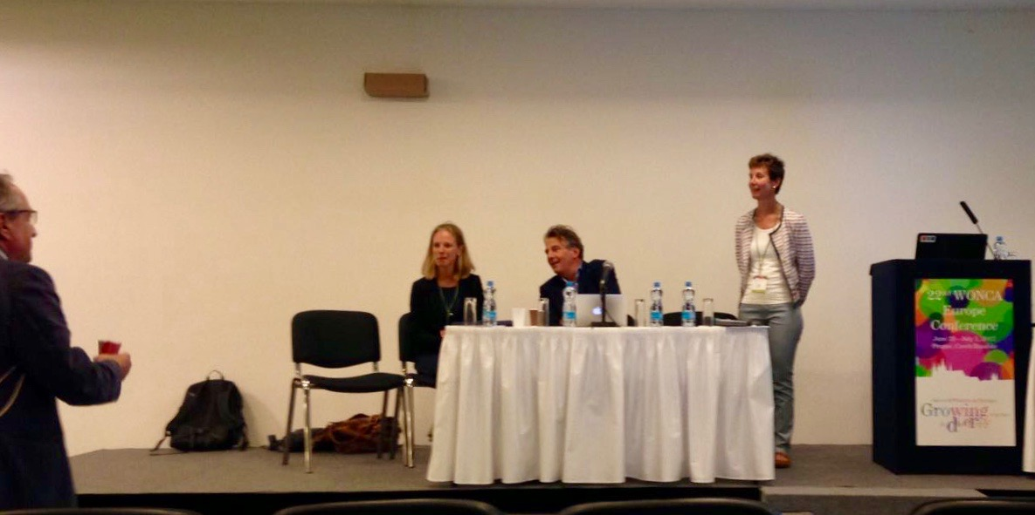
SPIMEU Newsletter January 2018
One of the SPIMEU presentations at WONCA 2017…
…and the following Q and A and discussions with the audience.

Slide 3
SPIMEU Newsletter January 2018
Work Package 5
The central task of WP5 relates to the critical review and evaluation of European CMD-prevention programs, with a particular focus on the process of intervention implementation and population uptake. As such, one of the main WP deliverables is a systematic review article on the factors that may inhibit or facilitate successful intervention roll-out.
We submitted a review manuscript to the Journal of Family Practice in July, and have since been invited by the editor to review and resubmit our original paper. We are currently awaiting their response to our revised submission. We are hoping for the best as we all believe that this is an important paper to publish.
In broad strokes, the article concludes that barriers and facilitators of the uptake of CMD prevention programs can be separated into five distinct categories: Structural, organizational, professional, social, and attitudinal. A full abstract and reference will be published on the SPIMEU website when and if the paper is accepted for publication.
Work Package 6
The purpose of WP6 centers on two principal goals: (1) to measure the attitude of general practitioners and the general population towards selective prevention of CMD, and (2) to assess acceptability and feasibility of an innovative implementation strategy for selective prevention in these two populations.
Preliminary results presented at the Prague consensus meeting in March, 2017, indicated that patients agreed that preventive health checks were useful. Further, GPs in general appeared to have a positive attitude towards selective prevention and considered it part of their job. Indeed, GPs routinely offered patients preventive health checks, and offered disease-management programs to patients at risk.
Since the consensus meeting, data collection has been completed and we are currently in the process of analyzing data and writing up results for publication. We will publish an abstract on the website once we have finished a first draft of the article.
Work Package 8
As mentioned on the previous page, WP8 will test the feasibility of implementing tailored selective prevention programs (designed in WP7) in five EU Member States (SWE, DNK, CZE, NLD, GRE), with a particular focus on GP and patient acceptance and participation rate. We finalized the protocol for this study in November, and are currently in the process of implementing the intervention in each of the five SPIMEU countries. We aim to have the final results in April, 2018.

Slide 4
SPIMEU UPCOMING EVENTS
SPIMEU Newsletter January 2018
WONCA 2018
The College of Family Physicians in Poland will host the 2018 WONCA Europe Conference from May 24-27, 2018, in Krakow Poland. Once again, the SPIMEU team will be there presenting the results of the various WPs. We will also conduct at least one workshop, focusing on the findings from the WP8 feasibility study and the conclusions of the WP2 ‘Tool Kit’ paper. The workshop will center on the dissemination of our acquired practical knowledge and guidance on the implementation of selective preventative measures targeting CMD. If our workshop abstract is accepted by the WONCA 2018 committee, we will publish an abstract on our website. We hope to see you at the conference!

