Slide 1
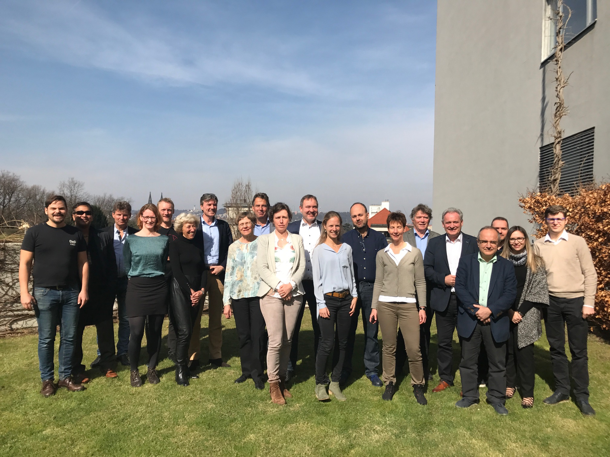
SPIMEU newsletter May 2017
In this SPIMEU newsletter you can read all about the SPIMEU meeting in Prague in March, 2017. We have also included updates on general progress and results. On the SPIMEU website www.SPIMEU.org you can find more information about the project and sign up for future SPIMEU newsletters.
SPIMEU consensus meeting, Prague, 2017
The SPIMEU project partners organized a consensus meeting in Prague on March 24-25 of this year. The purpose of the meeting centered on providing guidance for implementation of selective prevention programs in Europe. The consensus discussions were based on the first results of the SPIMEU project. The meeting thus involved the presentation and discussion of results concerning the identification and discussion of different CMD-prevention programs in the EU (WP4). It also included a review and evaluation of CMD-prevention programs, as well as an inventory of identified barriers and facilitators of intervention effectiveness – specifically in terms of patient lifestyle change and participation, as well as GP attitudes to prevention programs. This was discussed in terms of past CMD prevention initiatives globally (WP5) and more recent studies in the five SPIMEU member states. Six primary care and/or CMD experts from various EU member states were invited to the meeting to contribute to the revision and optimal specification of 32 potential CMD-program guidelines.
The SPIMEU partners and experts, Holiday Inn, Prague, Czech Republic, March 2017.
Work Package 4
The main objective of WP4 is to create an inventory for existing European CMD prevention programs and models, including an assessment of their strengths and weaknesses. To this end, experts in CMD and CMD prevention were invited to the meeting to assist the partners in critically assessing and refining a list of CMD prevention program guidelines. The experts were all GPs and or scientists with established track records in the field of preventive health care. A full set of guidelines will be published in the final SPIMEU report.

Slide 2
SPIMEU STATUS
Work Package 5
The central task of WP5 relates to the critical review and evaluation of European CMD-prevention programs, with a particular focus on the process of intervention implementation and population uptake. As such, one of the main WP deliverables is a systematic review article on the factors that may inhibit or facilitate successful intervention roll-out. At present, the literature search and review has been completed, and a first draft is circulating among the partners. A total of 28 articles was included in the review. In broad strokes, the article concludes that barriers and facilitators of the uptake of CMD prevention programs can be separated into five distinct categories: Structural, organizational, professional, social, and attitudinal. A full abstract will be published on the SPIMEU website once we have come up with a final draft of the manuscript.
Work Package 6
The purpose of WP6 centers on two principal goals: (1) to measure the attitude of general practitioners and the general population towards selective prevention of CMD, and (2) to assess acceptability and feasibility of an innovative implementation strategy for selective prevention in these two populations.
Preliminary results presented at the Prague consensus meeting indicated that all 250 patients agreed that preventive health checks were useful. Further, GPs in general appeared to have a positive attitude towards selective prevention and considered it part of their job. Indeed, GPs routinely offered patients preventive health checks, and offered disease-management programs to patients at risk.
Sweden
Denmark
The Netherlands
Greece
The Czech Republic

Slide 3
SPIMEU UPCOMING EVENTS – WONCA 2017
In June/July 2017, the Czech Society of General Practice will host the 22nd World Organization of National Colleges, Academies, and Academic Associations of General Practitioners (WONCA) Europe Conference in Prague. The aim of Wonca Europe is to improve global quality of life through fostering and maintaining high standards of care in general practice/family medicine. To this end, WONCA provides a forum for exchange of knowledge and information, encouraging and supporting the development of academic organizations of general practitioners/family physicians. The SPIMEU team will be there, hosting workshops and giving talks and updates on our project. Specifically, we have planned the following activities:
Workshop, 16:30-17:45, Friday, June 30, Meeting Hall 4 : Selective prevention of cardio-metabolic diseases across Europe: What’s the hold up?
This workshop will feature two 15-minute talks on the differences in attitudes towards CMD-preventive care between and among general practitioners and patients. The factors that may underpin these attitudes will also be discussed. The talks will be followed by discussion on how to deal with such differences in opinion as we move forward with the SPIMEU project.
WP2 & WP8
In addition to participation in WONCA 2017, the SPIMEU team is currently planning a steering group meeting on June 28 immediately before the conference. Here, we will discuss the next steps of SPIMEU with particular reference to WP2 and WP8. WP2 relates to the devleopment of a ”tool-box” with recommendations for the design and implementation of CMD-prevention programs in all EU members states. The recommendations will be based on the results generated from the SPIMEU project, and will as such be the final deliverable of the project.
WP8 focuses on implementation of selective prevention interventions. Specifically, this WP will test the feasibility of implementing the tailored selective prevention programs (designed in WP7) in five EU Member States (SWE, DNK, CZE, NLD, GRE), specifically in terms of their acceptance and participation rate.

